Slide 1
DIP-UNIT-V Pattern Recognition

Slide 2
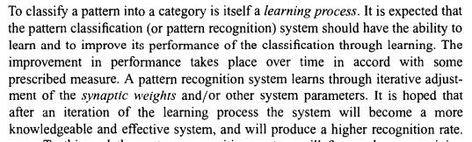
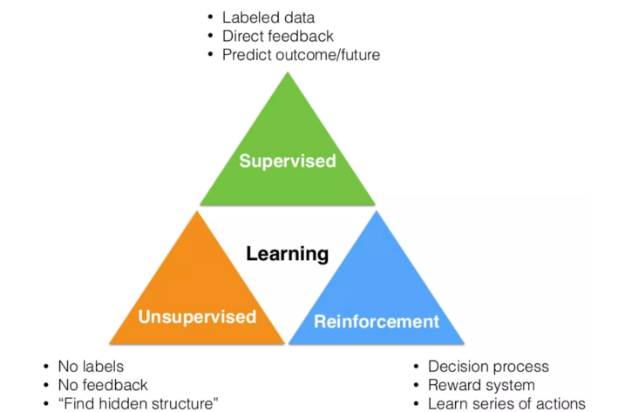
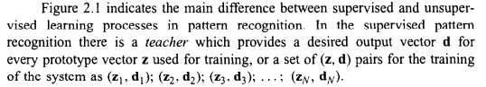
Supervised and Unsupervised learning

Slide 3
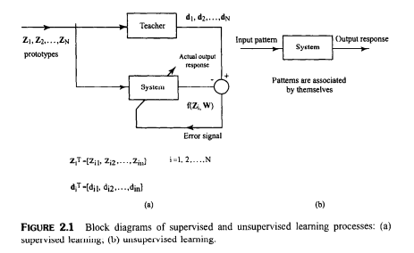
Supervised and Unsupervised learning

Slide 4
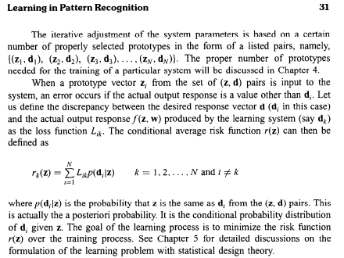
Supervised and Unsupervised learning

Slide 5
Supervised Pattern Classification
These approaches categorised in to two approaches
1. Parametric Approaches
2. Non Parametric Approaches

Slide 6
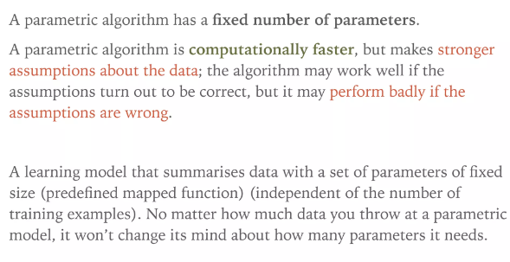
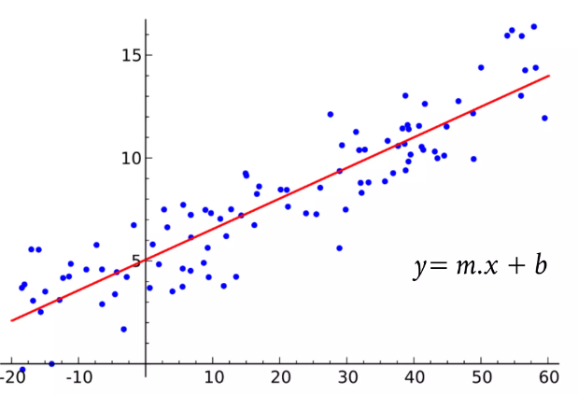
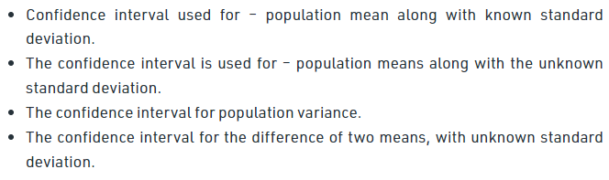
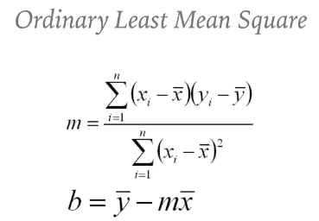
Parametric Decision Theoretic Classification

Slide 7
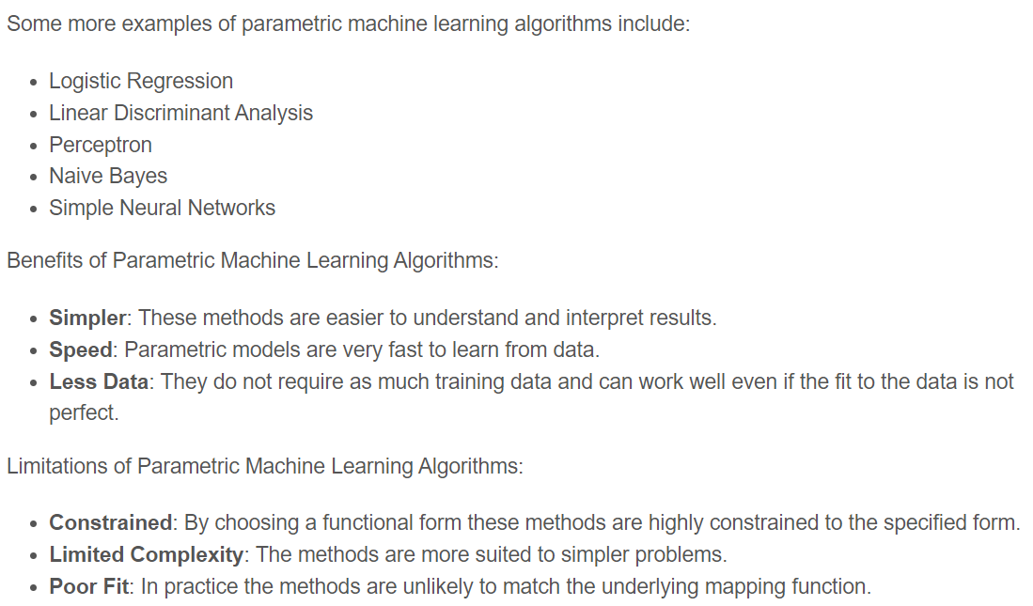

Slide 8
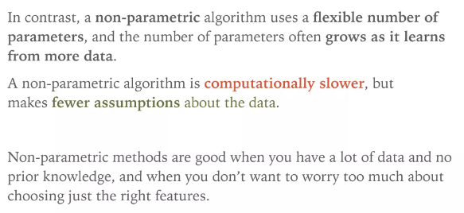
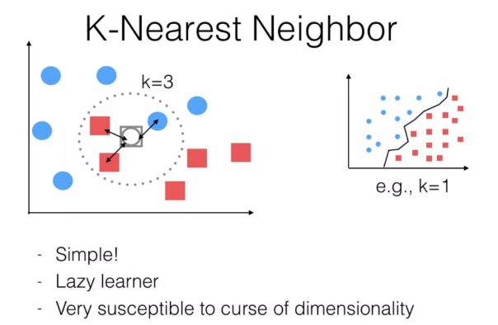
Non Parametric Decision Theoretic Classification

Slide 9
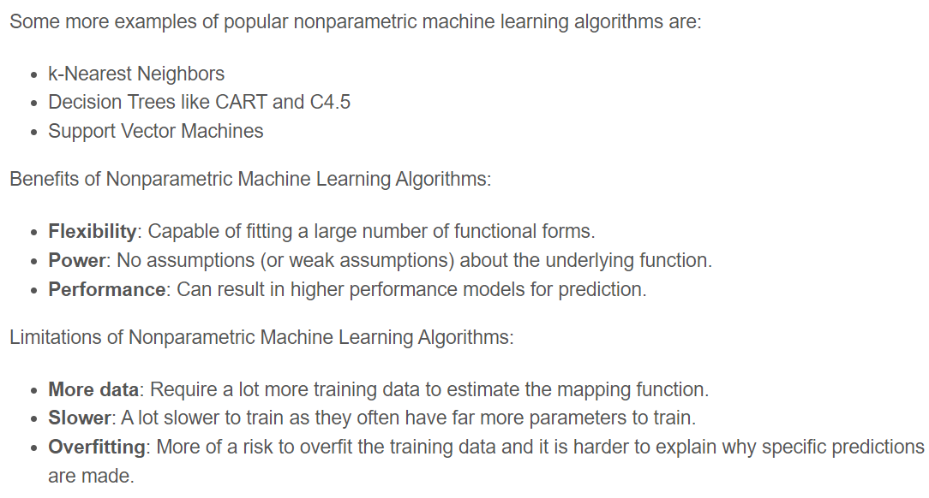

Slide 10
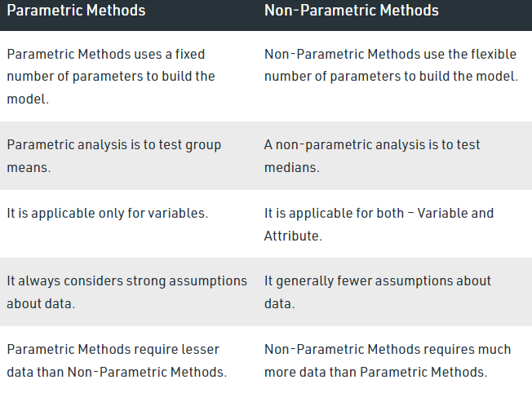

Slide 11
Non Parametric Decision Classification

Slide 12
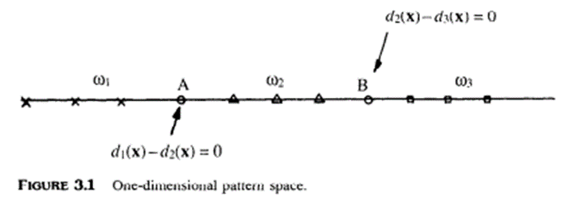
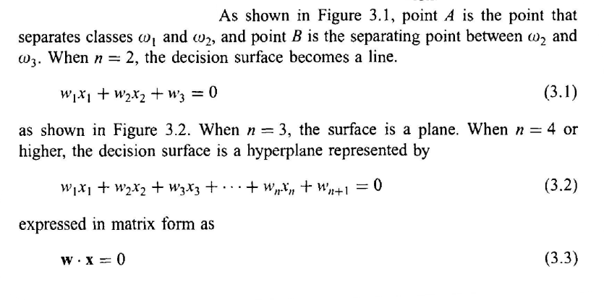
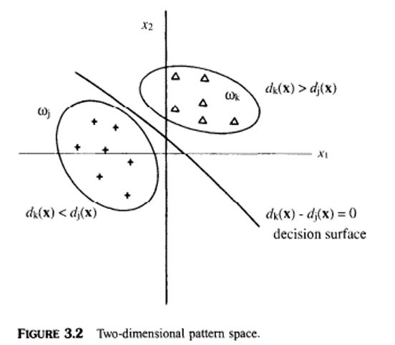
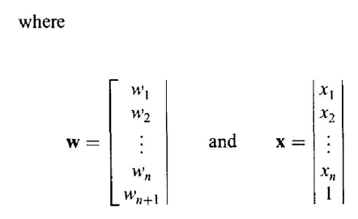
DECISION SURFACES AND DISCRIMINANT FUNCTIONS
Decision Surfaces:
Patterns pertaining to different classes will fall into different regions in the pattern space. That is to say, different classes of patterns will cluster in different regions, and can be separated by separating surfaces. Separating surfaces, called decision surfaces,

Slide 13
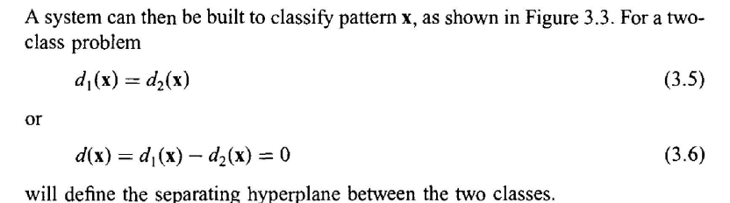
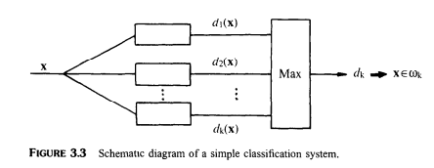

Slide 14
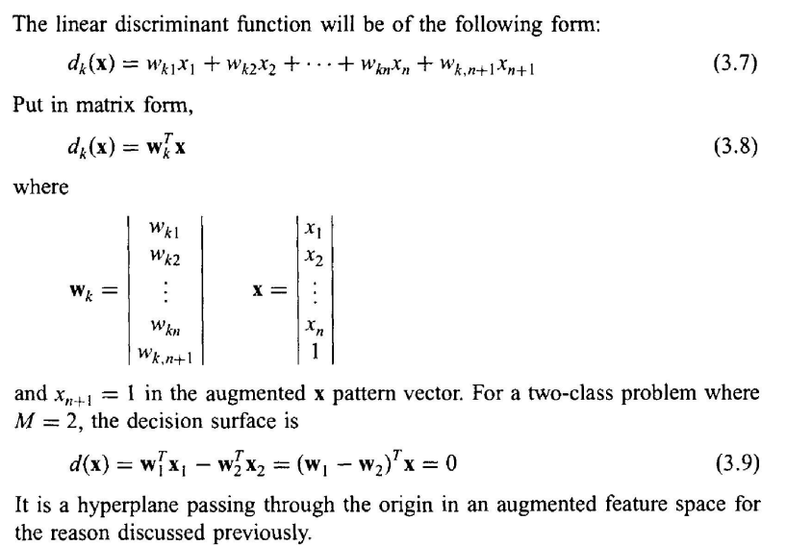
Linear Discriminant functions
Discriminant functions:
Patterns falling in different regions in the pattern space can be grouped into different categories by means of separating surfaces which are defined by discriminant functions.
The discriminant function may be linear or nonlinear according to the nature of the problem.
General form:

Slide 15
Minimum Distance Classifier
The minimum distance classifier is used to classify unknown image data to classes which minimize the distance between the image data and the class in multi-feature space. The distance is defined as an index of similarity so that the minimum distance is identical to the maximum similarity.
Minimum distance to means classifier is a non-parametric algorithm and based on training sample data sets for features of interest.
In this algorithm the spectral distance between the measurement vector for the candidate pixel and the mean vector for each signature is calculated.
The equation for calculating spectral distance is based on the equation for Euclidean distance.
After computing the distances, the candidate pixels are assigned to the class that is spectrally closer (minimum distance) to the sample mean.
The pixels remain unclassified if it is beyond than an analyst defined distance from any category mean
It is computationally faster than other supervised algorithms but it does not consider class variability and often leads to misclassification.

Slide 16
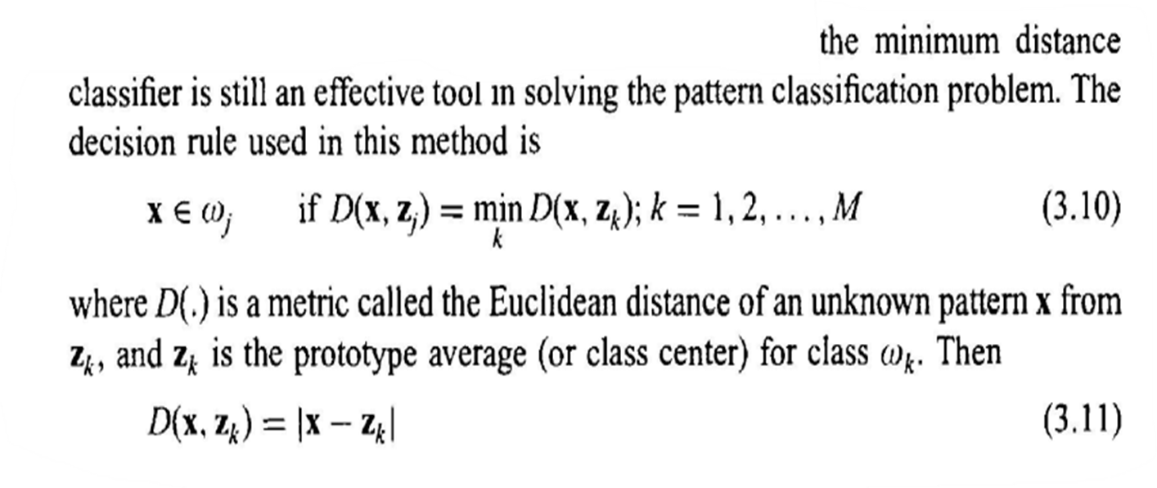
Procedure Min Distance Classifier Algorithm

Slide 17
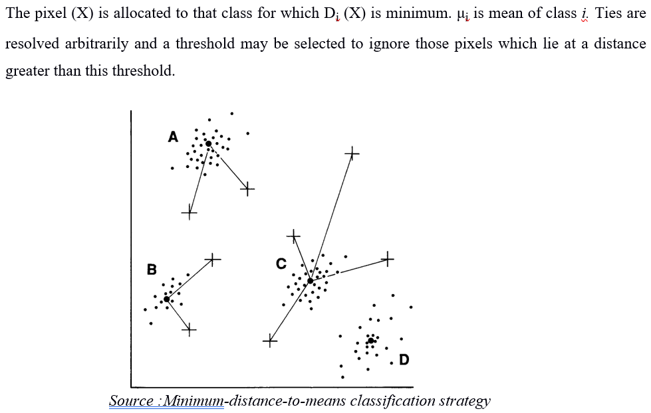
Fig Minimum distance classifier. Here the small dots represent pixels from training fields and the crosses represent examples of large numbers of unassigned pixels from elsewhere on the image. Each of the pixels is assigned to the closest group, a measured from the centroids (represented bythe larger dots) using the distance measures discussed in the text

Slide 18
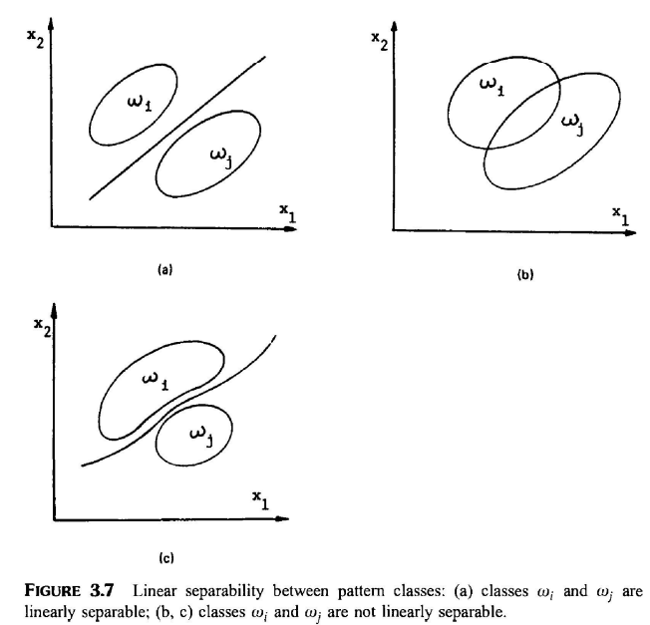
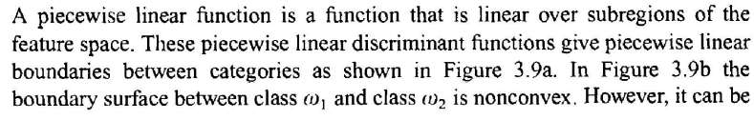
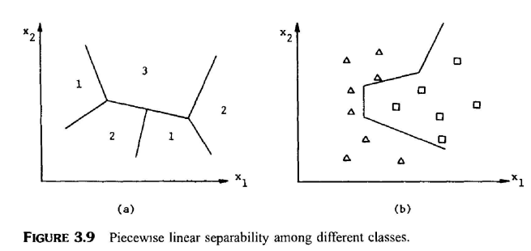
PIECEWISE LINEAR DISCRIMINANT FUNCTIONS
Linearly separable problems seem relatively simple, but in our real world most problems are linearly non-separable, and therefore more effective approaches must be sought. One way to treat these linearly non-separable problems is to use piecewise linear discriminant function.
Definition and Nearest-Neighbour Rule

Slide 19
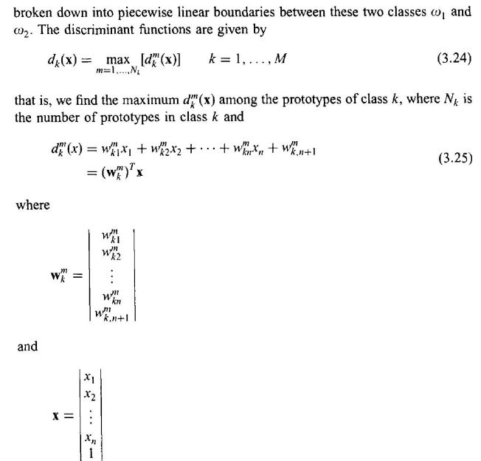
PIECEWISE LINEAR DISCRIMINANT FUNCTIONS

Slide 20
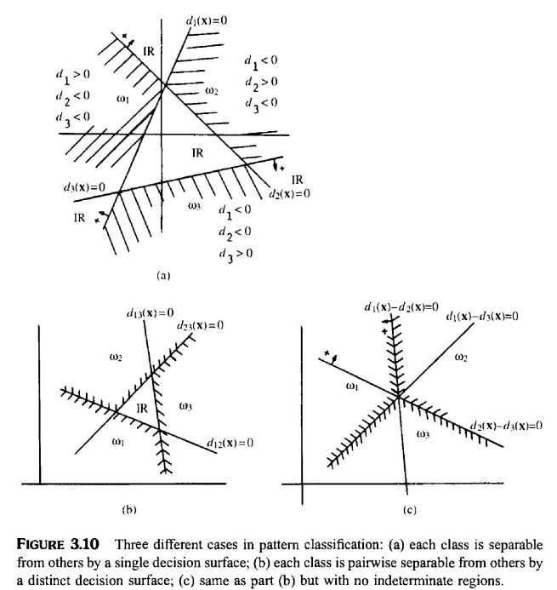
PIECEWISE LINEAR DISCRIMINANT FUNCTIONS
Three different cases of the pattern classification problem can be enumerated:

Slide 21
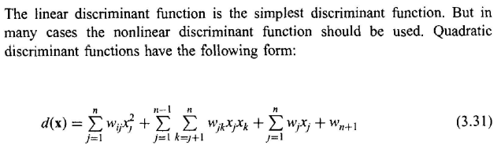
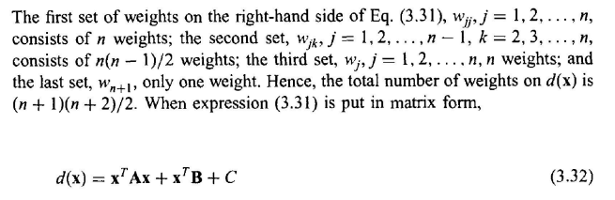
NONLINEAR DISCRIMINANT FUNCTIONS

Slide 22
Statistical discriminant functions

Slide 23
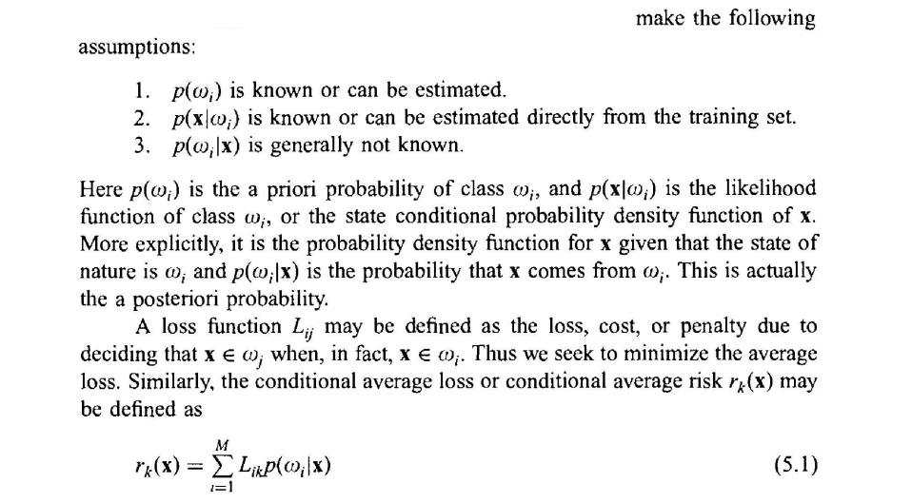
Statistical discriminant functions
The use of statistical discriminant functions for classification is advantageous because
considerable knowledge already exists in areas such as statistical communication, detection theory, decision theory, and so on, and this knowledge is directly applicable to pattern recognition; and
(2) statistical formulation is particularly suitable for the pattern recognition problem, since many pattern recognition processes are modelled statistically.
PROBLEM FORMULATION BY MEANS OF STATISTICAL DESIGN THEORY
Loss Function

Slide 24
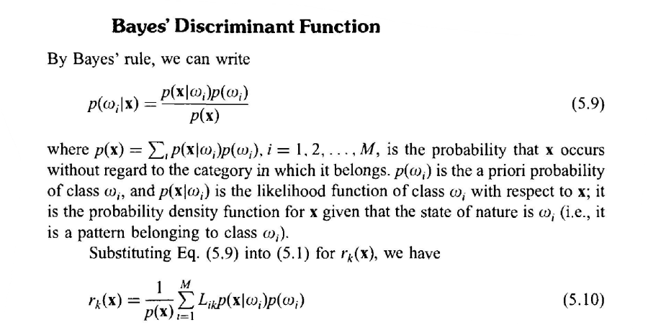
Baye’s Discriminant Function

Slide 25
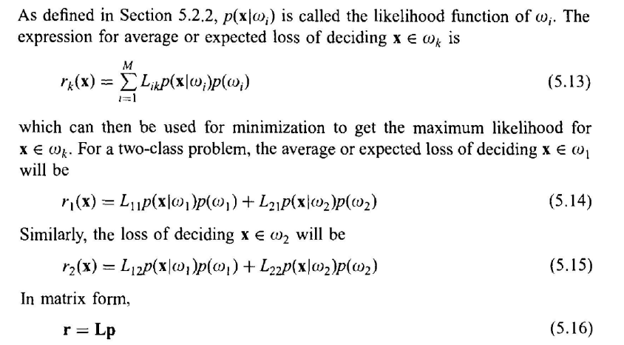
Maximum Likelihood decision

Slide 26
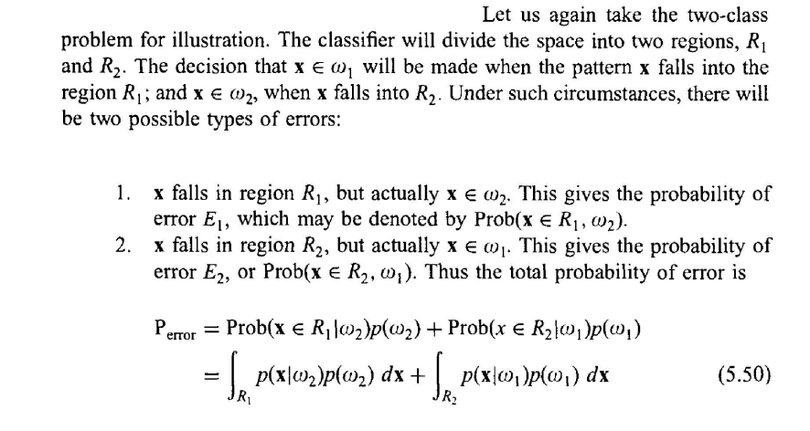
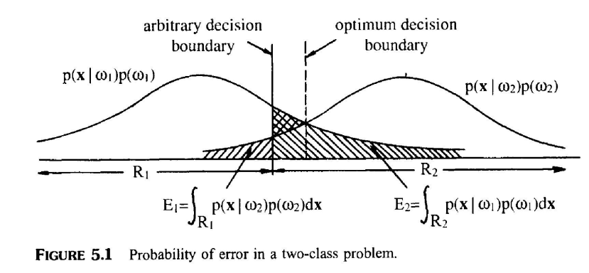
Probability Error

Slide 27
Clustering Analysis

Slide 28
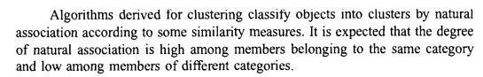
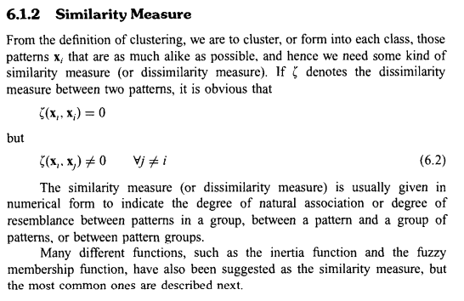
Clustering Analysis and Un supervised learning

Slide 29
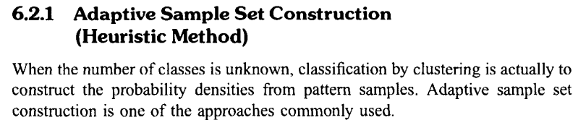
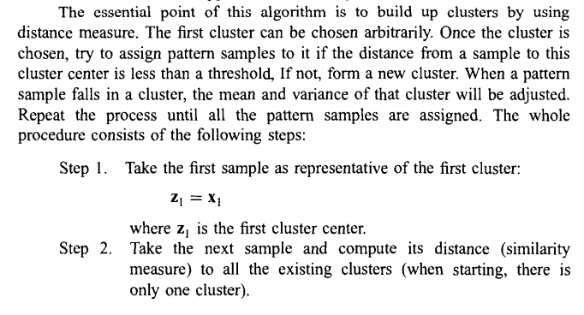
Clustering with Unknown number of Clusters

Slide 30
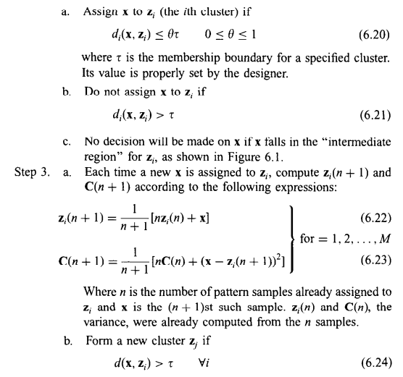

Slide 31
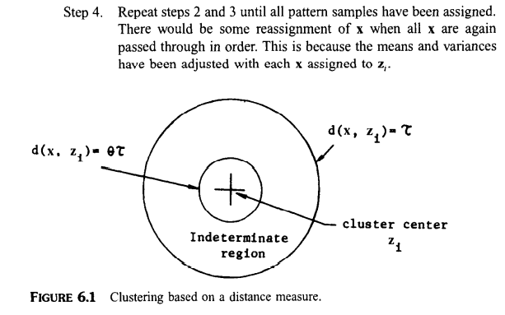

Slide 32
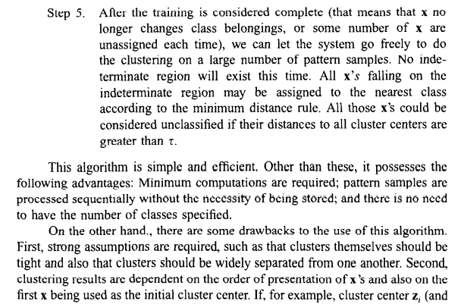

Slide 33
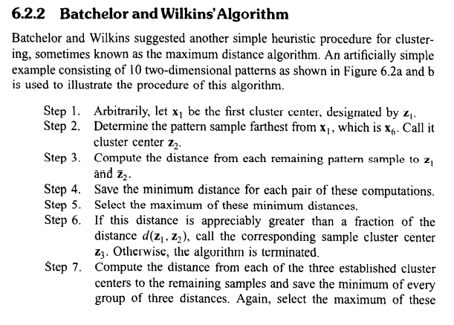
**Heuristic procedure for clustering also called maximum distance algorithm

Slide 34
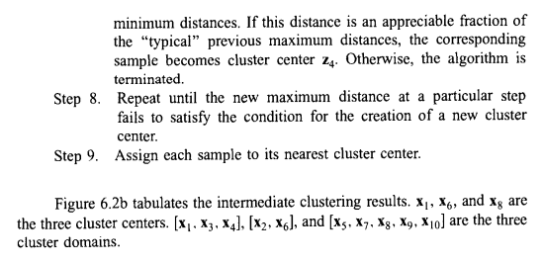
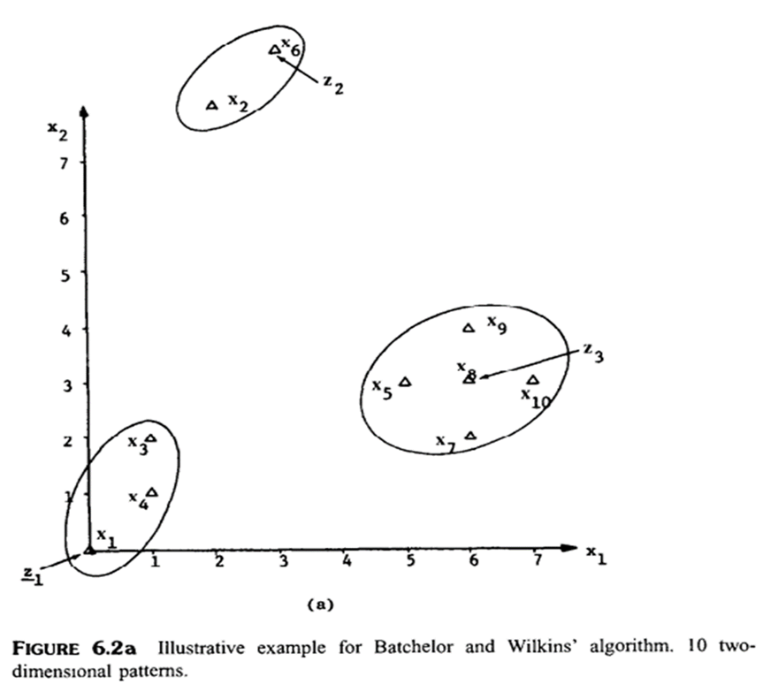

Slide 35
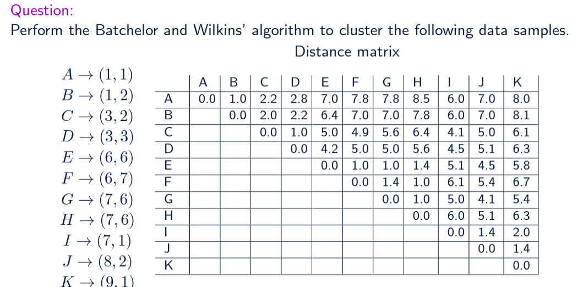

Slide 36
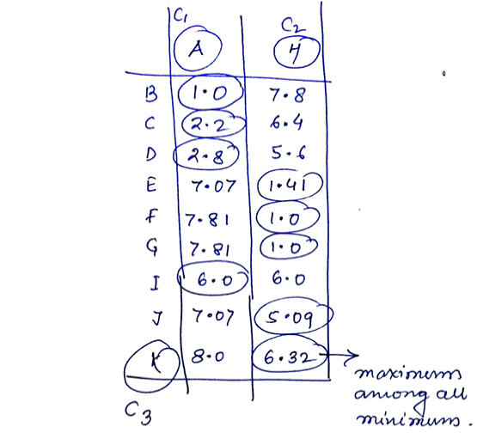
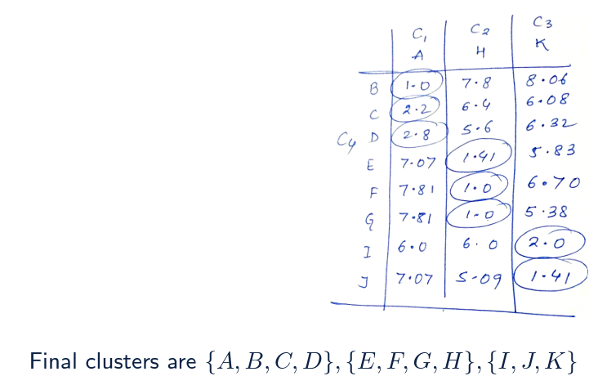

Slide 37
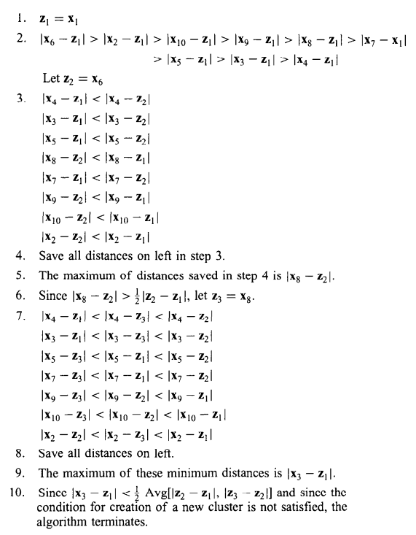
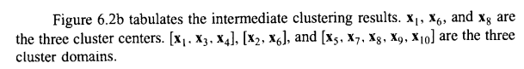

Intermediate Clustering results

Slide 38




Slide 39



Hierarchical clustering based on kNN

Slide 40



Hierarchical clustering based on k-NN

Slide 41

K-NN clustering Algorithm

Slide 42




Slide 43


Example NN Clustering

Slide 44


Example 3

Slide 45



Slide 46
Clustering with a known number of Classes k-Means Clustering ISODATA Clustering

Slide 47
K-Means Clustering
The working of the K-Means algorithm is explained in the below steps:
Step-1: Select the number K to decide the number of clusters.
Step-2: Select random K points or centroids. (It can be other from the input dataset).
Step-3: Assign each data point to their closest centroid, which will form the predefined K clusters.
Step-4: Calculate the avarage and place a new centroid of each cluster.
Step-5: Repeat the third steps, which means reassign each datapoint to the new closest centroid of each cluster.
Step-6: If any reassignment occurs, then go to step-4 else go to FINISH.
Step-7: The model is ready.

Slide 48





Example

Slide 49





Slide 50





Slide 51





Slide 52



Slide 53



Example 2

Slide 54



Slide 55
ISODATA Clustering Algorithms:
The ISODATA clustering algorithm is a type of clustering that uses an iterative, self-organizing process. During each iteration, the algorithm assigns all samples to existing cluster centers and recalculates new means for each class.
The ISODATA algorithm is similar to the k-means algorithm, but the ISODATA algorithm allows for different numbers of clusters. The k-means algorithm assumes the number of clusters is known beforehand.
The ISODATA algorithm performs unsupervised classification by calculating class means evenly distributed in the data space. It then iteratively clusters the remaining pixels using minimum distance techniques. Each iteration recalculates means and reclassifies pixels with respect to the new means.
The process continues until the number of pixels in each class changes by less than the selected pixel change threshold or the maximum number of iterations is reached.

Slide 56

Basic Idea

Slide 57


ISODATA Clustering Algorithm

Slide 58


Slide 59

Algorithm

Slide 60

Example:

Slide 61



Slide 62



Slide 63



Slide 64



Slide 65
Dimensionality Reduction, Feature Selection
PCA:

